Slide 1

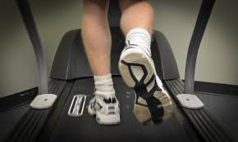
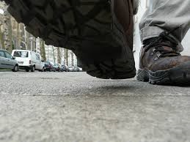



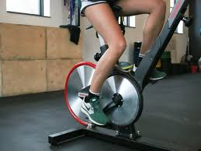

Sonja Ellicott – UX & Design
Shelley Tennison – HW Dev
Al Hulaton – HW Dev
Catherine Karra – SW Dev
Sakshar Thakkar – SW Dev
Camila Morrison – Product Manager
Team 9

Slide 2
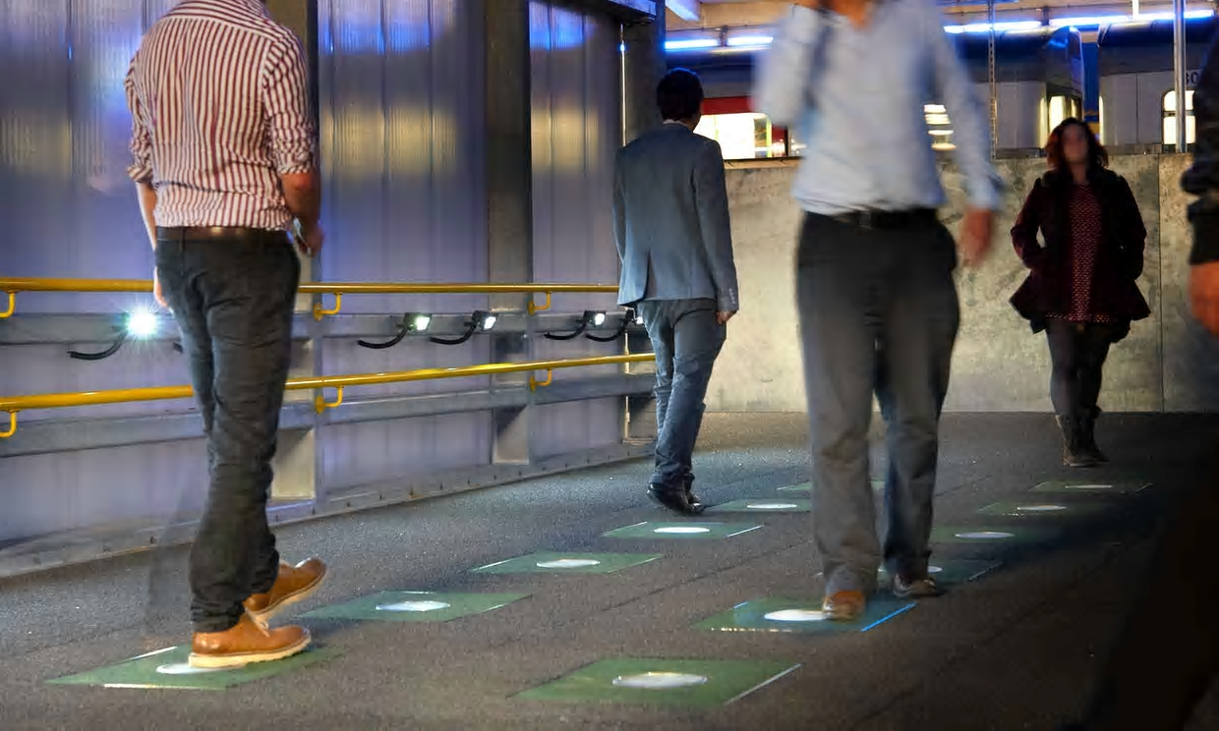
Human Motion Monitor for Kinetic Energy Generation
Photograph: Pavegen
smart tiles that capture the kinetic energy from pedestrians’ footsteps & convert it into electricity
Sustainability Opportunity
Our world needs more sustainable energy generation
Humans move around all day long
Sensors capture motions and convert to energy
kinetic (kə-nět'ĭk, kī-) adj. Of, relating to, or produced by motion.

Slide 3
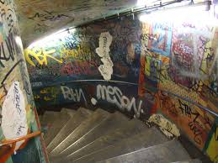
Solution
Hand-held, portable measurement tool that captures kinetic energy
Use to identify highest ROI locations to create kinetic energy generation systems
A system designer can place unit in a gym, walkway, stairs to track amount of motion
Unit has screen for immediate feedback to designer after tracking timeframe
Data is sent to cloud database to hold results & provide recommendations
Demo – Hardware & Software

Slide 4
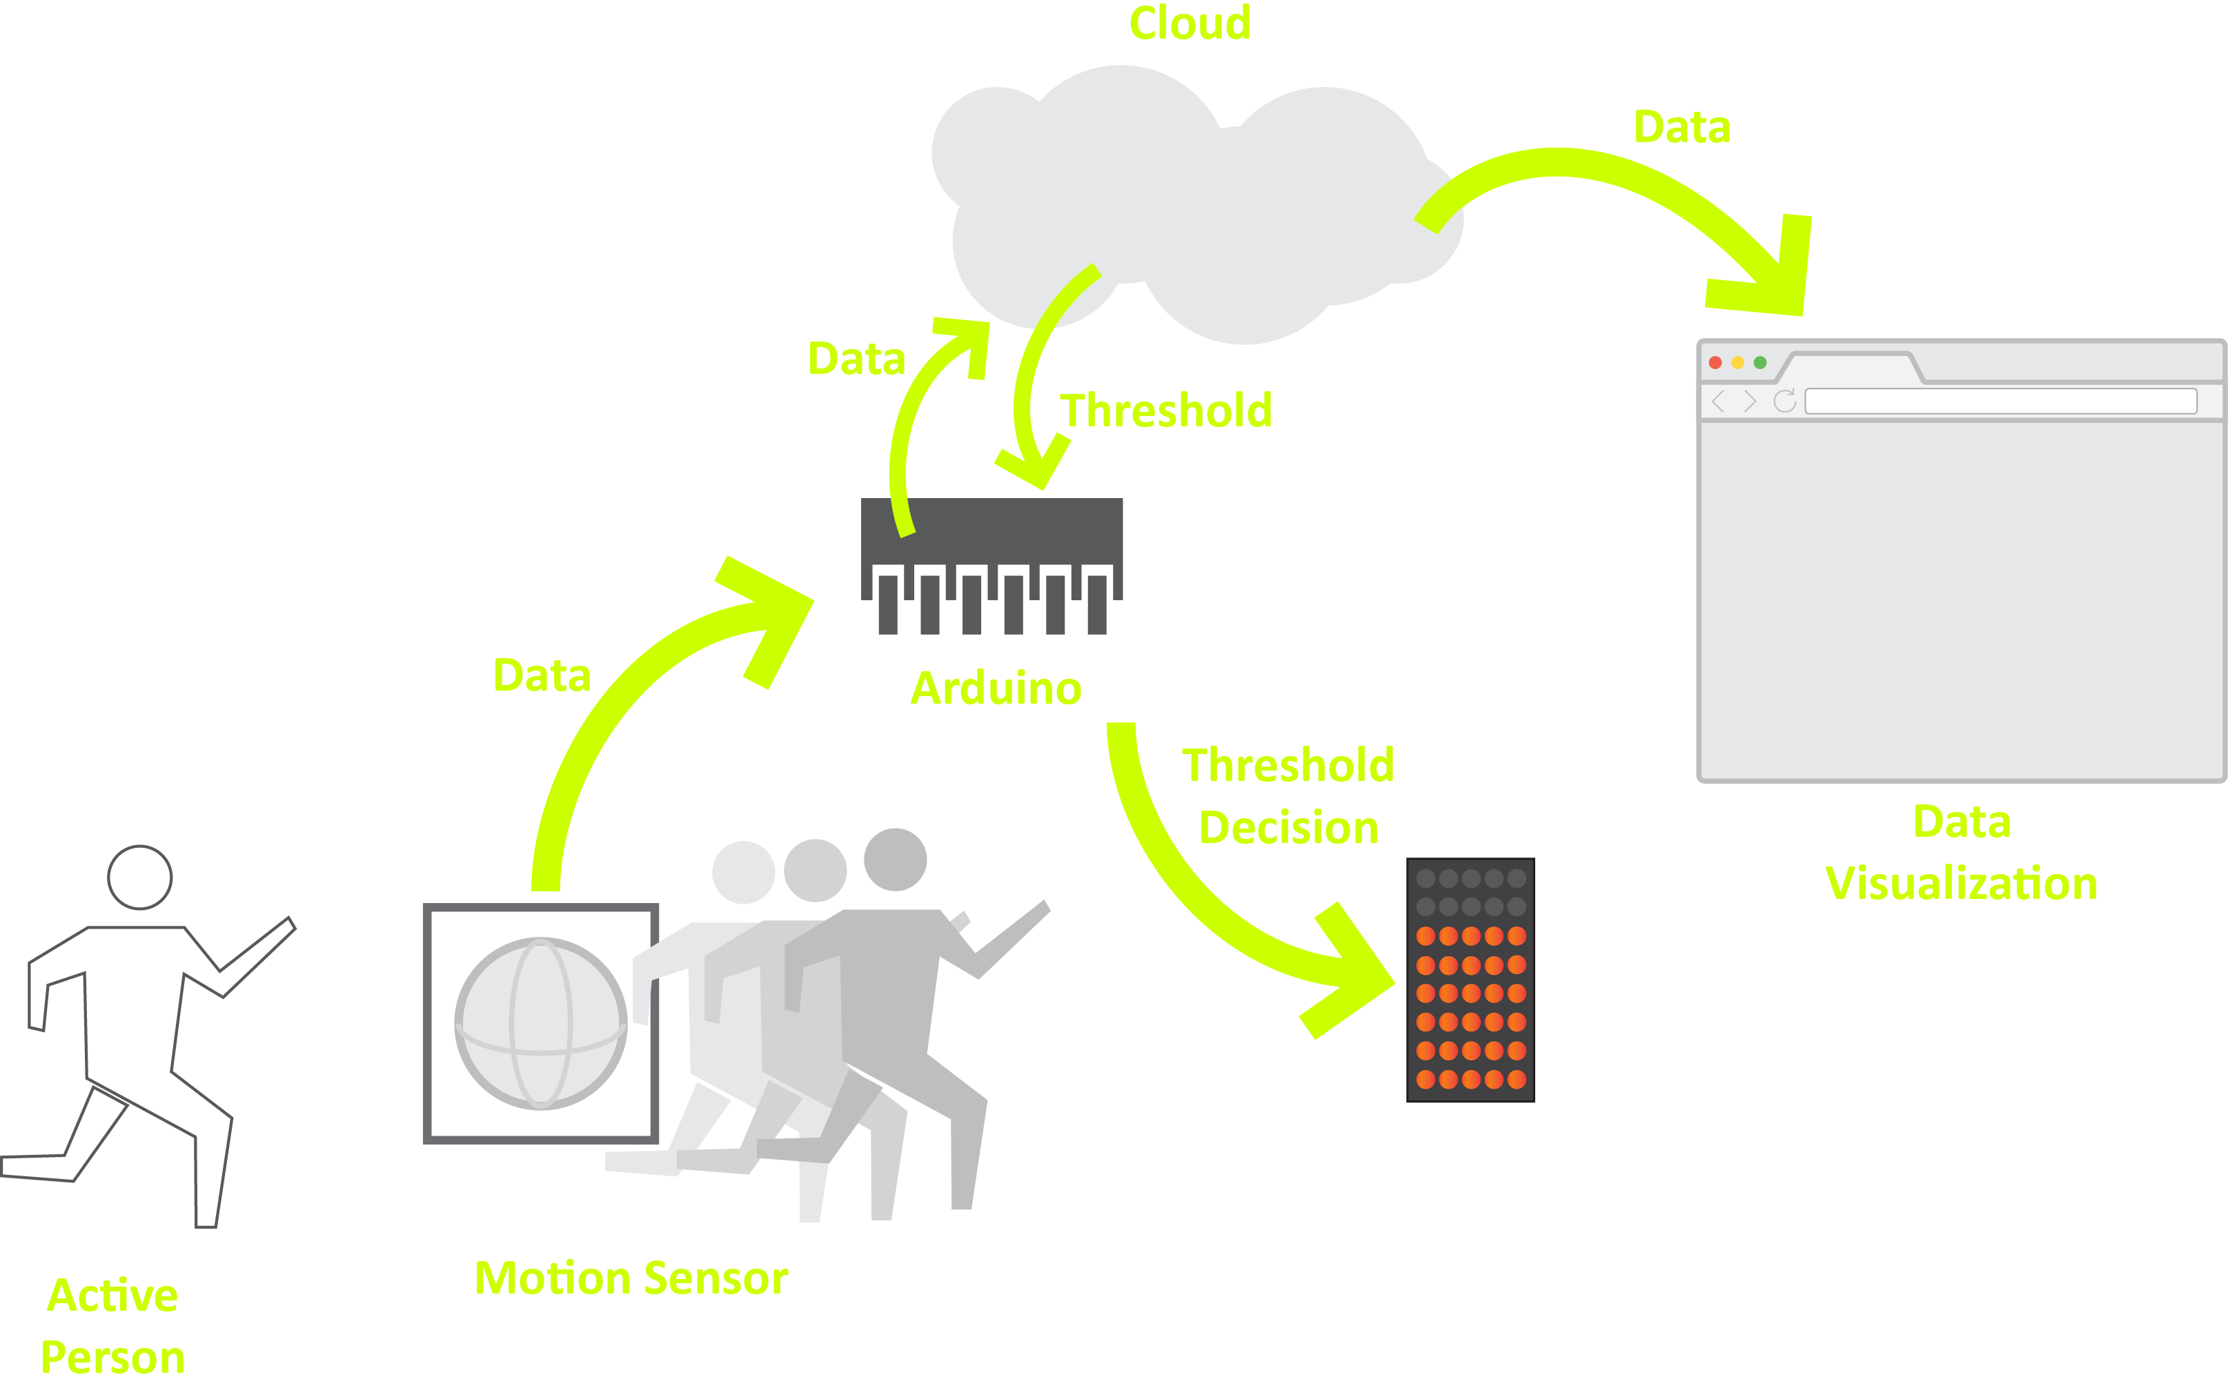
How Works

Slide 5


Slide 6
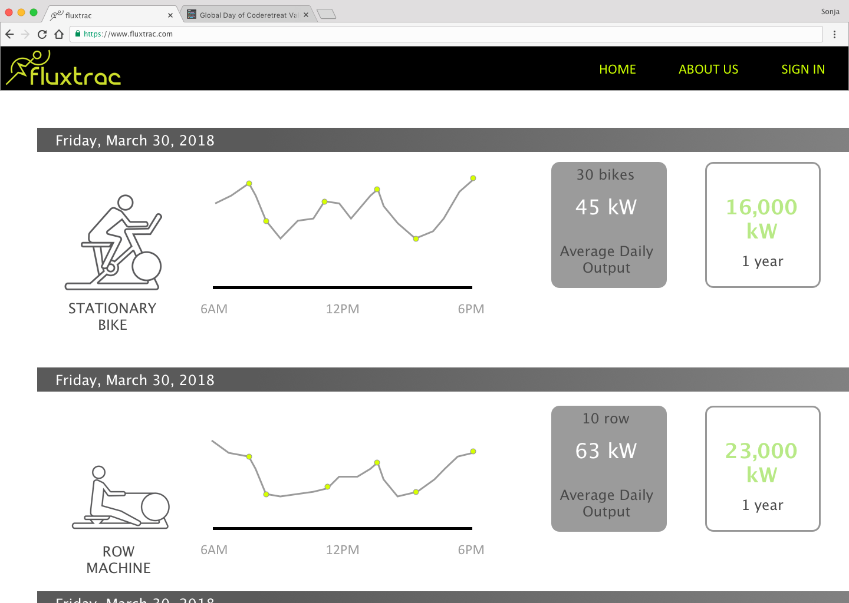

Slide 7
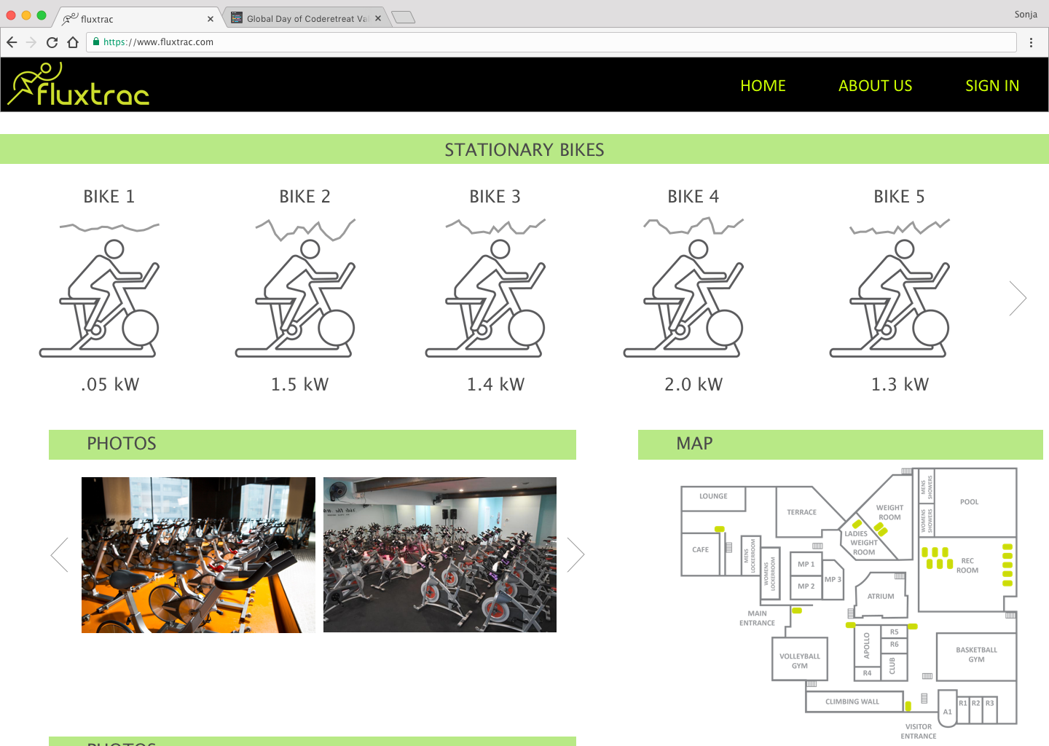

Slide 8

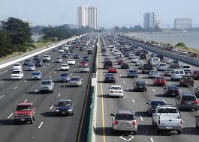
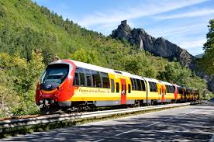
Future Opportunities
Apply to other movements

